Slide 1

BIG DATA PROJECT
PRESENTATION
PRIYANKA UNNIKRISHNAN
S180030100336

Slide 2

INDEX
BIG DATA
HADOOP
BIG DATA IN REAL TIME
BIG DATA -4 V’S
HADOOP
HDFS
HDFS ARCHITECTURE
YARN
MAPREDUCE
PIG
HIVE
SQOOP
PROJECT OVERVIEW
TOOLS USED
BENEFITS OF H1B VISA

Slide 3

BIG DATA
Big data is data sets that are so voluminous and complex.
Traditional data processing application software are inadequate to deal with them.
Big data challenges include capturing data, data storage,dataanalysis,search, sharing, transfer, visualization, querying, updating and information privacy.

Slide 4

BIG DATA IN REAL TIME
Public Sector Services.
Healthcare contributions.
Learning Services.
Insurance Services.
Industrialized and Natural Resources.
Transportation Services.
Banking Sectors and Fraud Detection.

Slide 5
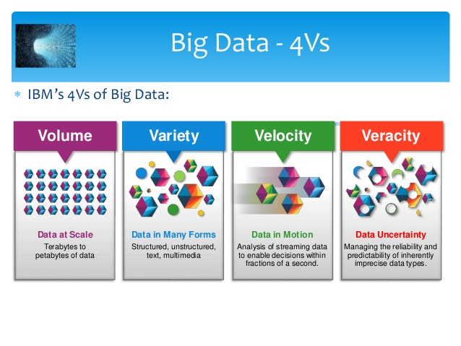

Slide 6
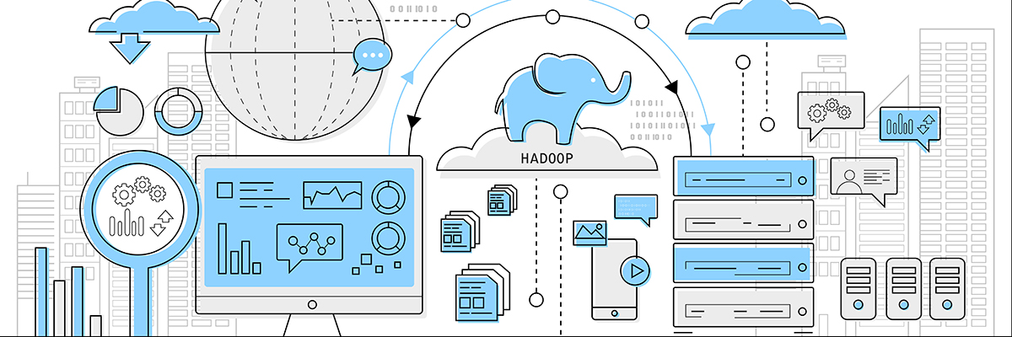

Slide 7

HADOOP
Apache Hadoop is an open-source software framework used for
distributed storage and processing of dataset of big data using the
MapReduce programming model.
The core of Apache Hadoop consists of a storage part, and a processing part which is a MapReduce programming model.
This approach takes advantage of data locality, where nodes manipulate the data they have access to.

Slide 8

HDFS
COMPONENT: Master Node
Slave Node
Master Node(Name Node):-
- Manages a caption of each data nodes in the hdfs storage.
Slave Node(Data Node):-
- Contains the actual data in the hdfs storage.

Slide 9
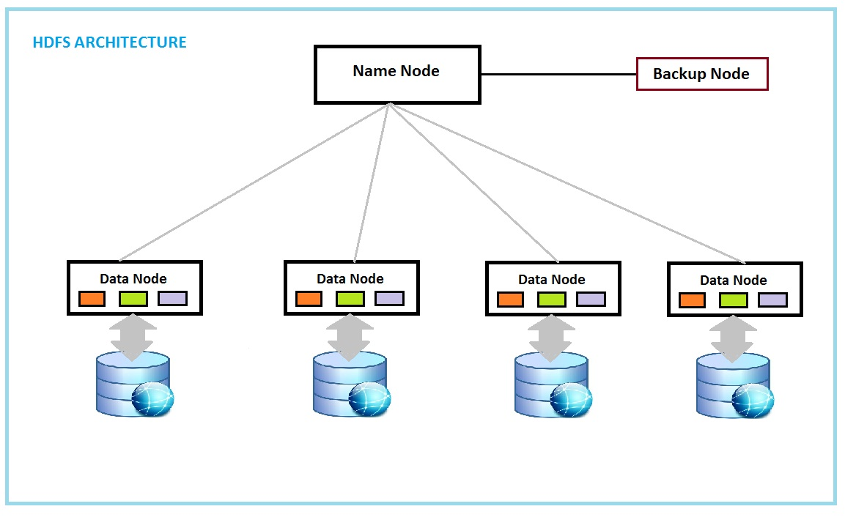

Slide 10
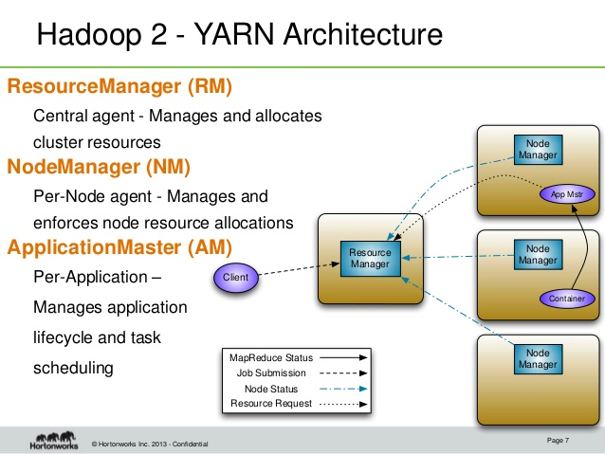

Slide 11
MAP REDUCE
MapReduce divides a task into small parts and assigns them to many computers.
Later, the results are collected at one place and integrated to form the result dataset.
The term MapReduce actually refers to two separate and distinct tasks that Hadoop programs perform.
The first is the map job, which takes a set of data and converts it into another set of data, where individual elements are broken down into tuples (key/value pairs).
The reduce job takes the output from a map as input and combines those data tuples into a smaller set of tuples.
As the sequence of the name MapReduce implies, the reduce job is always performed after the map job.

Slide 12
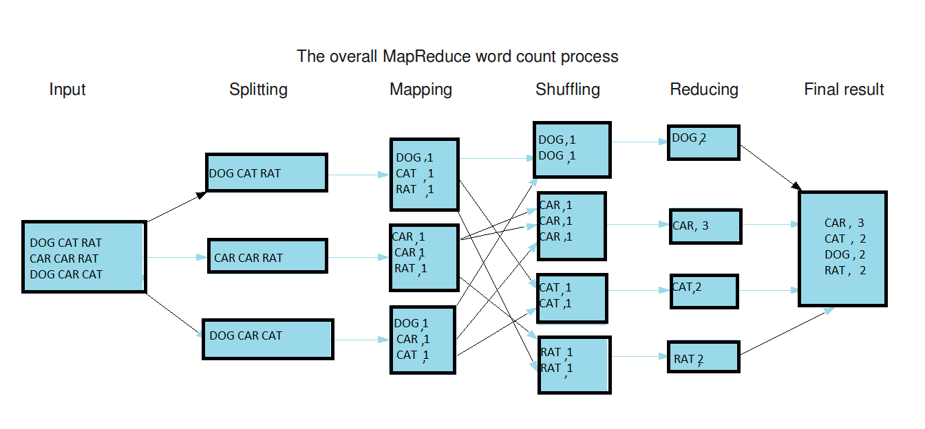

Slide 13

PIG
It is a tool/platform which is used to analyze larger sets of data representing them as data flows.
To write data analysis programs, Pig provides a high-level language known as Pig Latin.
To analyze data using Apache Pig, programmers need to write scripts using Pig Latin language.
All these scripts are internally converted to Map and Reduce tasks.
Apache Pig has a component known as Pig Engine that accepts the Pig Latin scripts as input and converts those scripts into MapReduce jobs.

Slide 14

HIVE
It is a platform used to develop SQL type scripts to do MapReduce operations.
Hive is a data warehouse infrastructure tool to process structured data in Hadoop.
Initially Hive was developed by Facebook, later the Apache Software Foundation took it up and developed it further as an open source under the name Apache Hive.

Slide 15

SQOOP
Sqoop is a tool designed to transfer data between Hadoop and relational database servers.
It is used to import data from relational databases such as MySQL, Oracle to Hadoop HDFS, and export from Hadoop file system to relational databases.

Slide 16

PROJECT OVERVIEW
Completed my project on the H1B visa , and analysed the data based on the needs stated.
The h1b visa data set, wide-range activity, which takes place once a decade in the entire country.
Its purpose is to gather information about the general population, in order to present a
full and reliable picture of the population in the country - its housing conditions
and demographic, social and economic characteristics.
The information collected includes data on, S_no,case_status,Employer_name,Job_title,
Soc_name,Soc_code,Job_title,Full_time_position,Previling_wages,Year,Work_site,Lon,Lat .

Slide 17

TOOLS USED:
MAPREDUCE- java
PIG
SQOOP
HIVE

Slide 18

BENEFIT OF H1B VISA
Everyone, including immigrants, benefits from investments in education, health care, and jobs that are distributed based on census information.
And census data are also used in ways that are of special importance to immigrants, including: finding the talented persons in each and every country by giving high pay.
country economy gets improved because of those immigrants and the technology gets proved standary of the people living in the country gets improved evaluating the effectiveness of equal opportunity employment programs and policies under the Civil Rights Act; allocating funds school districts for children with limited English language proficiency.

Slide 19

THANK YOU

